Slide 1

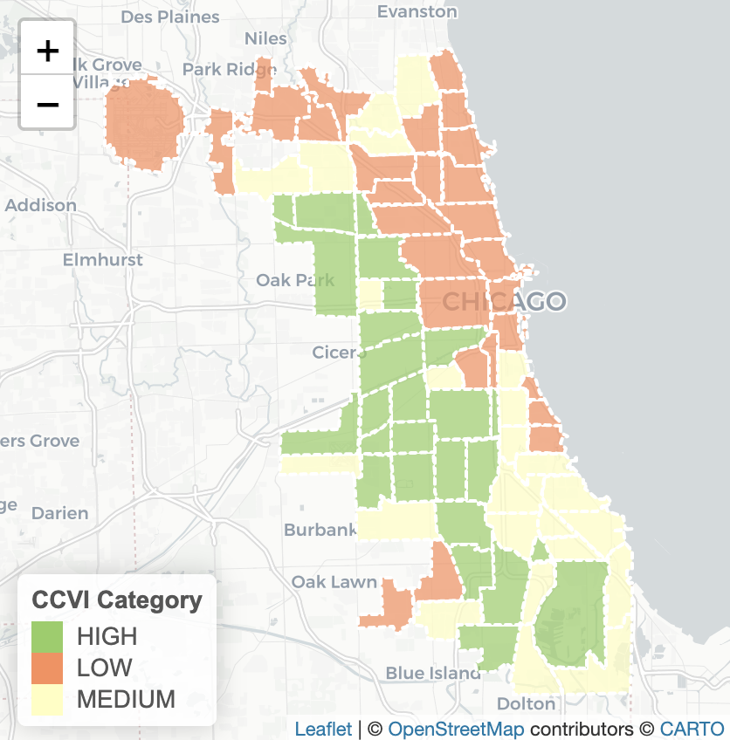
In the space below to copy/paste/insert a custom version (new color palette) of Figure 1 (map of CCVI Scores by Community Area) from the exercise.
GEO 3330 Sustainable Urban Transportation
Exercise #2: L Station Ridership Trends
Describe here any patterns you see in the map. Use data from the map to describe characteristics of at least one community located within each of the three CCVI categories.
The data shows that the south and southwest regions of Cook County were more vulnerable to COVID. West Lawn has a CCVI score of 48.5 which categorizes it as HIGH. Its socioeconomic status is 50 meaning residents risk their socioeconomic status due to COVID. Hyde Park has a CCVI score of 16.7 which is very low, and their socioeconomic status is 16 which is low risk for those residents. West Ridge has a MEDIUM vulnerability because of their score of 36. Their socioeconomic status is 35, which is mild vulnerability when compared to other neighborhoods.

Slide 2
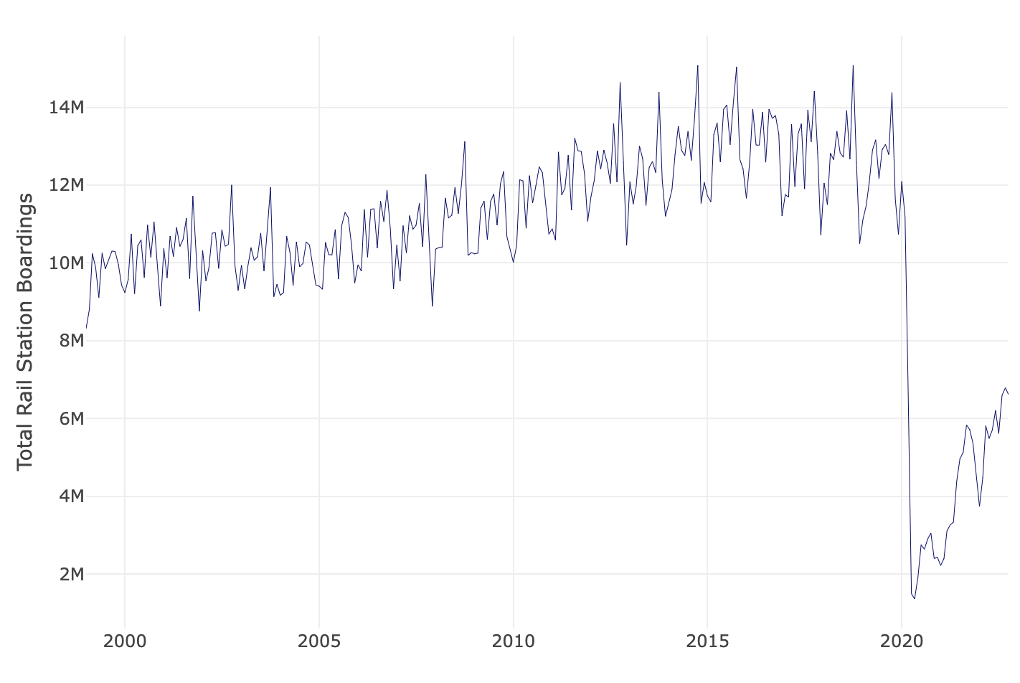
In the space below to copy/paste/insert Figure 2 or 3 from the exercise.
GEO 3330 Sustainable Urban Transportation
Exercise #2: L Station Ridership Trends
Describe patterns in rail boardings between 1999 and 2022. What do you think explains some of the cyclical variations in the data? What other factors may explain ridership over this period? Draw from the daily ridership plot to characterize ridership trends during the pandemic.
From 1999 to about October 2019, ridership steadily increased from around 8.3 million to 14.4 million. The variations throughout the months seemed to stem from the colder months, usually declining after October before rising again around March of each year. Most people would rather drive to work since stations don’t really accommodate for the weather other than a few heat lamps. Ridership dropped very dramatically from around 11.2 million in February to its lowest 1.4 million in May 2020.

Slide 3
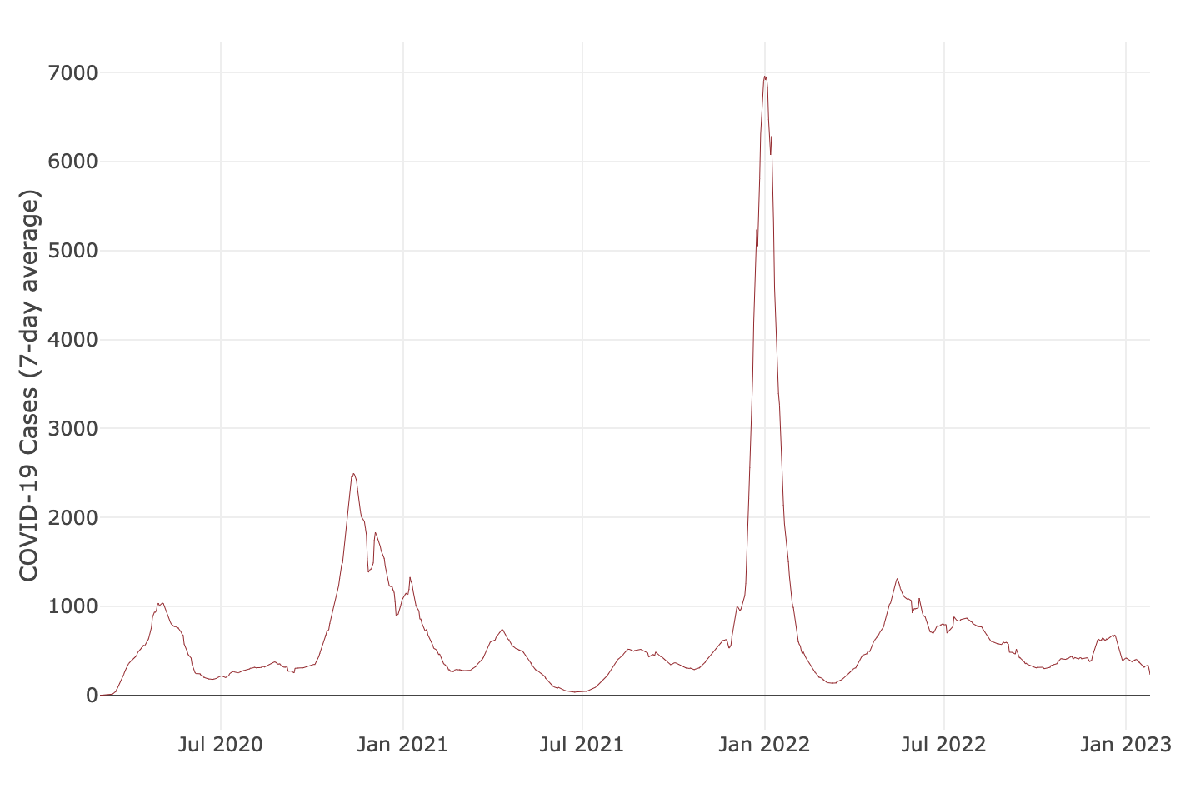
In the space below to copy/paste/insert Figure 4 from the exercise.
GEO 3330 Sustainable Urban Transportation
Exercise #2: L Station Ridership Trends
Are the waves and phases of the pandemic evident? Compare these pandemic phases to ridership trends over the same period. Do they appear to be related?
The waves are shown with the spikes in May and November of 2020, and the highly infectious Omicron variant in January 2022. Yes, the trends are related in which whenever COVID cases increased, ridership decreased with it. In Figure 2 there was a drop in ridership from October 2021 to January 2022 which coincides with the sharp increase in Figure 4 for the same time period.

Slide 4
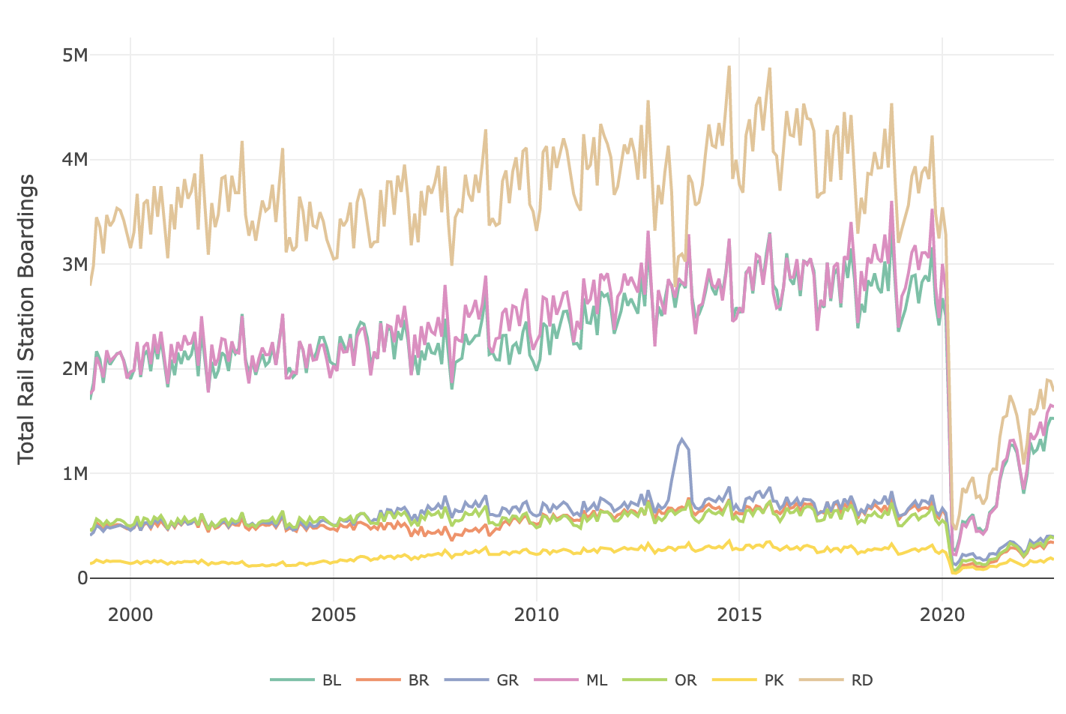
In the space below to copy/paste/insert Figure 5 or 6 from the exercise.
GEO 3330 Sustainable Urban Transportation
Exercise #2: L Station Ridership Trends
How does ridership vary with respect to station CCVI and line?
The lines with historically high ridership boardings and more stations experienced the most dramatic drops in ridership. CCVI played a factor in which stations near the lowest vulnerability experienced the biggest decline while those with higher vulnerabilities didn’t drop as much. I think this may have to do with higher CCVI scores’ population needing the public transportation regardless of risk whereas lines near more affluent populations could afford to not use it. It follows the data from Figure 1 where the south and southwest neighborhoods were most vulnerable. Green, Orange and Pink lines go through these areas.

Slide 5
Summarize some potential short- and longer-term implications the pandemic has had on sustainable transportation and public transit ridership?
GEO 3330 Sustainable Urban Transportation
Exercise #2: L Station Ridership Trends
Some short-term implications are decreased and slow climbing levels of riders which in turn reduces the fares collected. This may increase a budget deficit which is difficult to come back from. The pandemic did decrease the number of operators due to sickness which has and will continue to impact the reliability and frequency of rides for years to come.
What strategies do you propose to help return transit to pre-pandemic levels?
Increase efforts in the hiring departments of public transportation institutions like the CTA, Pace and Metra to try and return the number operators to normal and if possible, surpass to have more frequent trains which will make the system more dependable. They can also advertise more to show that the vehicles are as clean as they can be so people trust riding in safety. I also think they should invest in updating their fleets to newer models of train cars and buses to show a new and improved version of the system to attract new riders (people who have probably never considered using it before the pandemic).

